Slide 1


Stock Price Prediction
Group 5:
Adnan Shakil
Raviteja Sankuratri

Slide 2
Scope
Scope of this project is to be able to download latest stock price data from online repository.
Ability to download latest technical data of any stock.
Pre-process data into required format.
Build a neural network which can use the data to predict stock price.
Adjust hyper parameters to observe impact of results.
Produce chart & Table for predicted future price.

Slide 3
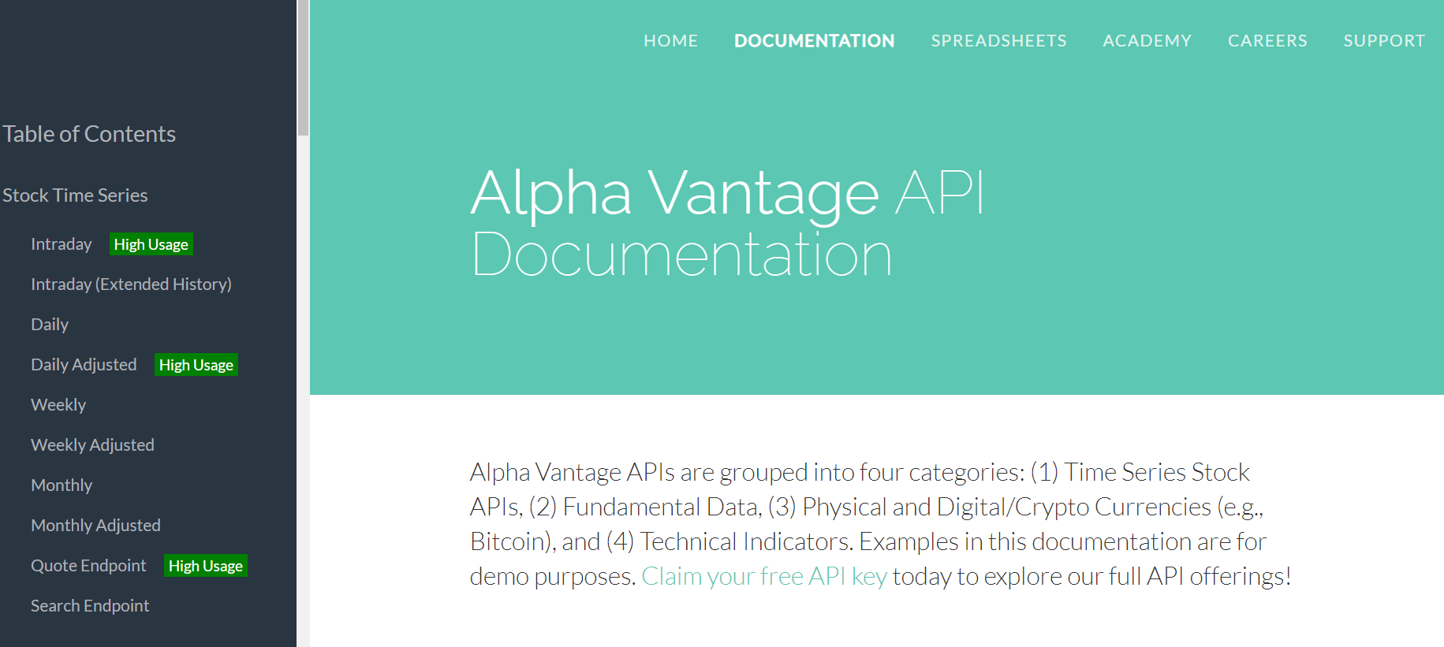
Data Acquisition
Using API for AplhaVantage website which provides real time data for stocks & technical indicators.
https://www.alphavantage.co/

Slide 4
Data Preprocessing
The API allows only 5 queries per minute
Using the API Downloaded following data
Stock price :high, low, open, close, volume
Simple Moving Average (SMA)
Stochastic Indicator (STOCH)
On Balance Volume (OBV)
Moving Average Convergence Divergence (MACD)

Slide 5
Extracting Relevant Data
Extracted the required Data from all DataFrames
Joined them into one DataFrame using key ‘date’

Slide 6
Saving Data
Since API allows limited queries, it easier to save data to a CSV.
This avoids querying website again & again
Input Requires
API Key
Symbol
CSV File format = RNN + Symbol .csv

Slide 7
Selecting Desire Dates Range
Since csv file got 20 years of Data, its desirable to reduce the data size
Reindexed the Data frame & extracted 1 years Data

Slide 8
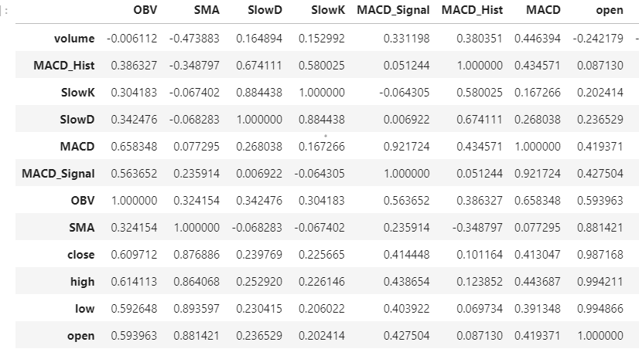
Correlation Between Data
Not all Data is relevant to the required output
Correlation between indicators & stock ‘open’ price is very important
Selected only the fields which correlated more than 50%.

Slide 9

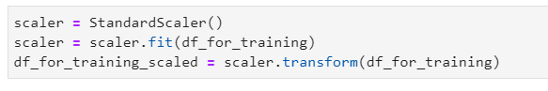
Data Normalization
Performed Data Normalization using Standard Scaler
MinMaxScaler was also tried but it didn’t give good results.

Slide 10
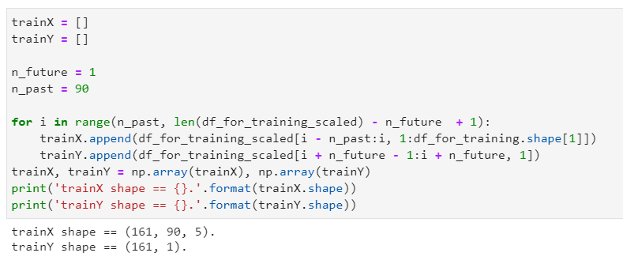
Training & Test Set
Since the scope is multivariate data input
A shifting approach is used to create Training & Test Set
90 days as training set & next day for Test

Slide 11
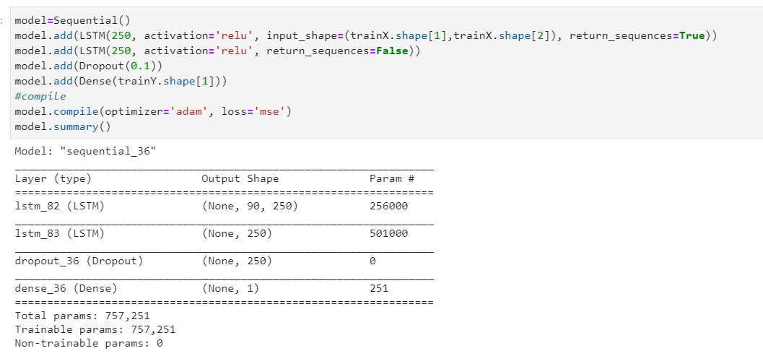
Building Neural Network Model
LSTM with 250 layers, Dropout rate of 0.1
Activation Function = Relu
Optimizer = adam
Loss = mean square error
Nadam & SGD were also tried, but they did not produce good results
Activation functions tanh, Sigmoid were also tried but the results were not good

Slide 12
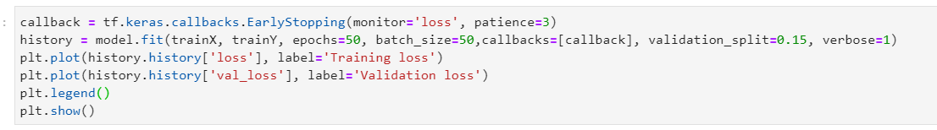
Apply Model
Model was applied using following hyper parameters
Callback = early stop with tolerance of 3
Epoch=50
Batch size = 50
Validation split = .15
A lot of different combinations of hyper parameters were tried. The results varies based on length of input data & selected indicators.

Slide 13
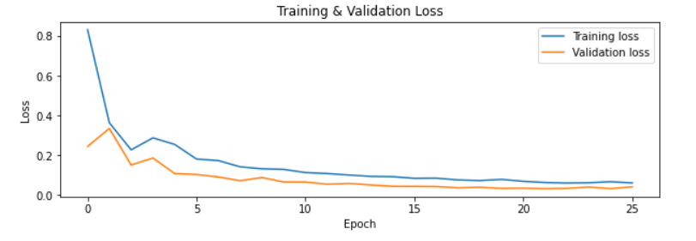
Training & Validation Loss

Slide 14
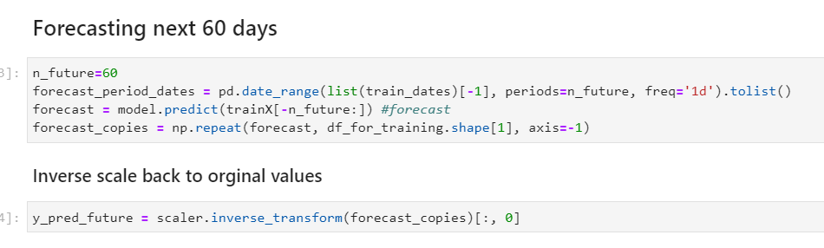
Inversing the price scaling Forecasting 60 days price

Slide 15
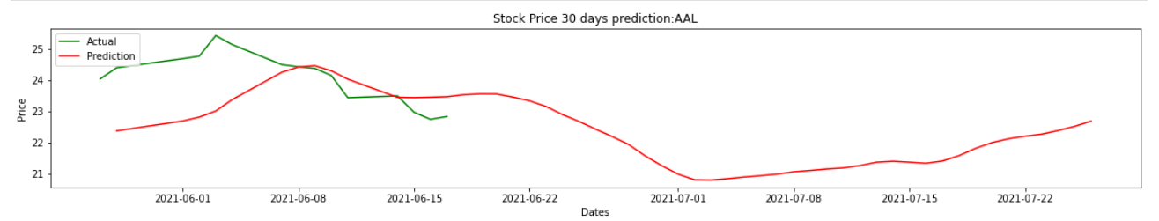
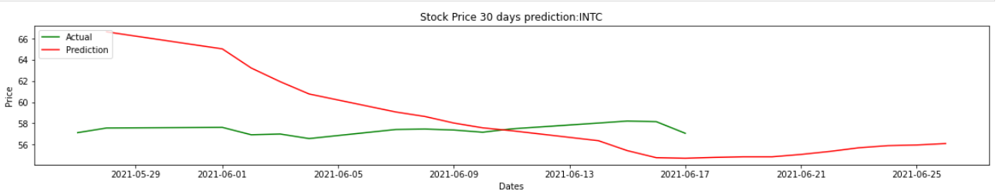
Plotting Predicted Price with Actual Price

Slide 16
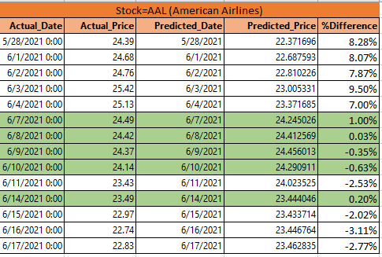
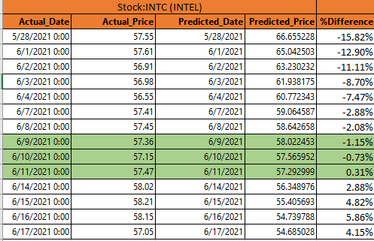
Actual & Predicted Price Table
Interestingly most of the time Model is able to predict very close to actual price of stock.

Slide 17
Conclusion
Predicting Stock Price is a complicated procedure.
The models are too sensitive to hyper parameter.
Price is sensitive to market volatility.
Preprocessing of Data is imperative to get encouraging results.
Training set, LSTM layers, Optimizer, Dropout rate & Validation Split plays key role in prediction.
A better accuracy can be achieved by further tweaking the model.

Slide 18

Thank You

